Slide 1
CONNECTED FACTORY
INTERNET OF THINGS

Slide 2
Challenges in Factory
Accelerating new product
Increase product production and quality
Mitigating unplanned downtime(reduces 5% production)
Securing factories from cyber threats
Decreasing high cabling and re cabling( consume 60%)
Improving worker productivity
Improving worker safety

Slide 3
Complication to Challenges
Executive management : new ways of manufacturing in a cost effective way balancing energy and material cost
Product Development: deals with time to market
Plant Managers: works to gain plant efficiency and operational agility(rapidly change or adapt in response to changes in the market)
Control and automation department: deals with plant network, controls and applications

Slide 4
IOT solutions for Connected Factories
Basic Sensors on factory floors:
It helps to achieve better connectivity
Sensors smart in communication using IP protocols over ETHERNET
Basic communication devices on factory floors:
Able to transmit and receive large quantities of real time information and diagnostic data
IP enable devices:
Video cameras, personal mobile devices and other smart objects

Slide 5
Smelting factory ( example)
Ores needs to be melted using HEAT AND CHEMICALS
It is a multi stage process
It requires DATA and CONTROLS
Data need to be changed time to time
Operators need to be on toe
IOT makes “ machine to people” possible
IOT helps in getting real time data
IOT results in improvement in Production and Quality

Slide 6
IOT solution using RTLS
RTLS : real time location system
RTLS uses Wi-Fi RFID tags
Tags are connected to material
Tags provide real time location and status of material
IOT helps material and component to talk to the network
IOT helps to track assembly line’s ( production line) output
IOT helps to SPEED UP or SLOW DOWN production
IOT provides check on employee regarding their speed of operations

Slide 7
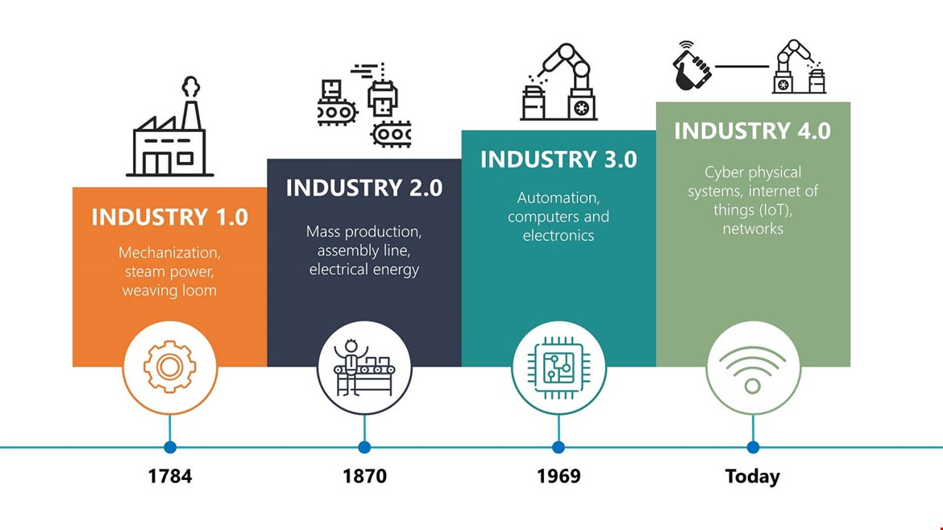
Industry Revolution

Slide 8
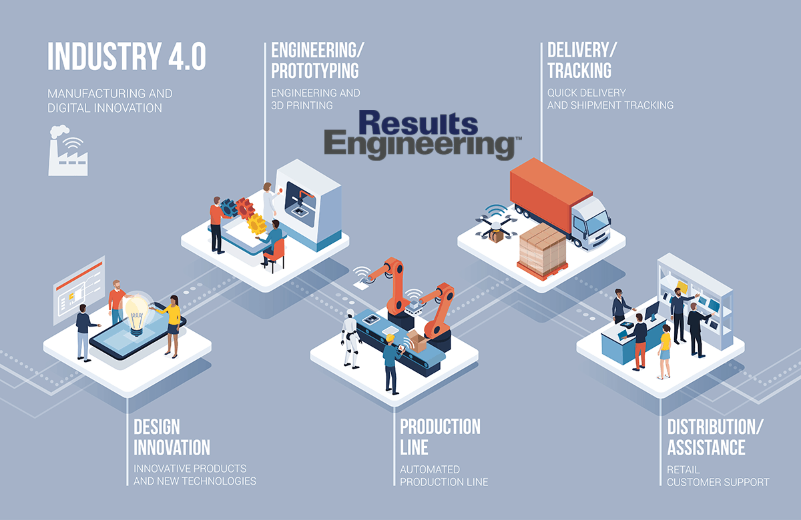
Industry 4.0

